Slide 1
PROGETTO ESERCIZIO 1
VERSIONE: PURE HTML
Giulia Meneghin: 10488640
Giuseppe Mauri: 10454364

Slide 2
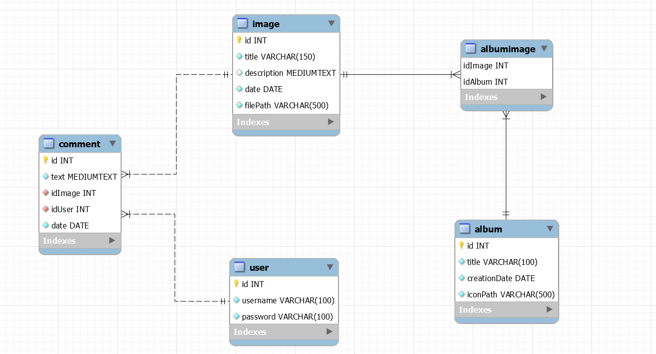
Database design

Slide 3
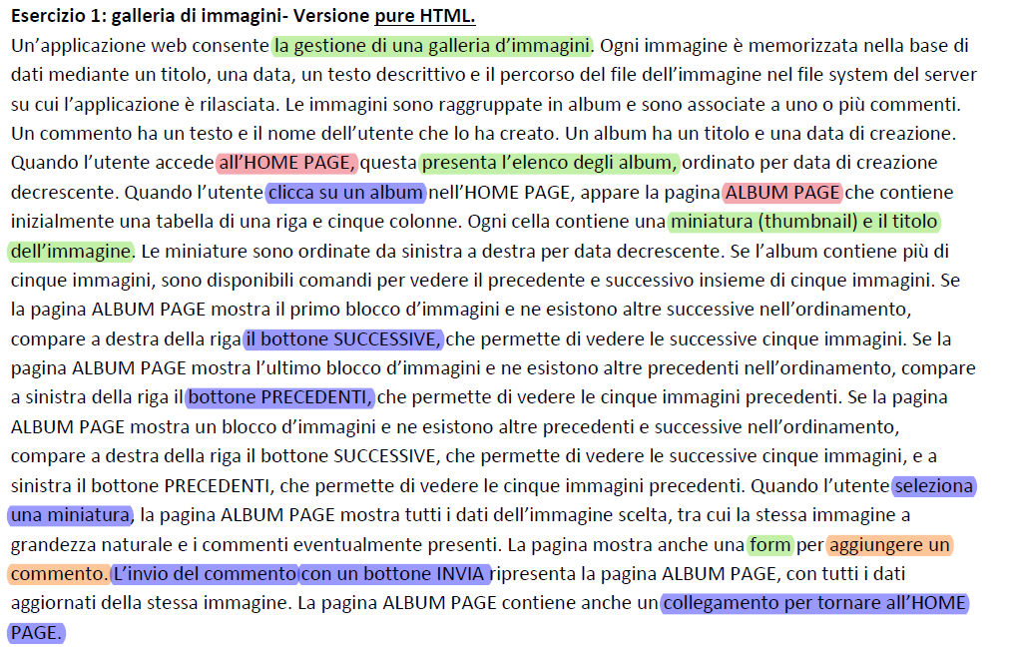
Application requirements analysis
Pages (views), view components, events, actions

Slide 4
Completamento delle specifiche
La web application è costituita da 3 pagine html:
-Index.html
-AlbumList.html
-ImageList.html
La pagina di Index.html contiene la form di login, un bottone per visualizzare la form di registrazione e un bottone per accedere come guest alla pagina AlbumList.html.
Sia la pagina AlbumList.html che ImageList.html mostrano in alto a destra il bottone di login se l’utente ha fatto l’accesso come guest oppure il bottone di logout se l’utente ha fatto l’accesso attraverso la form di login.
Il caricamento della pagina AlbumList.html mostra l’elenco degli album in ordine di data decrescente.
Selezionando un album si apre la pagina ImageList.html che mostra il primo gruppo di cinque immagini dell’album con i relativi bottoni next e previous. Viene inoltre scelta la prima immagine della lista come immagine a grandezza naturale di default. In alto a sinistra è inoltre presente un bottone che ti riporta alla pagina AlbumList.html.
Solo gli utenti loggati possono visualizzare la form per creare un nuovo commento.
Gli utenti guest possono solo visualizzare i commenti dell’immagine e un bottone che li reindirizza alla pagina index.html per loggarsi.
A seguito della creazione di un nuovo commento se ne visualizzano i dettagli.

Slide 5
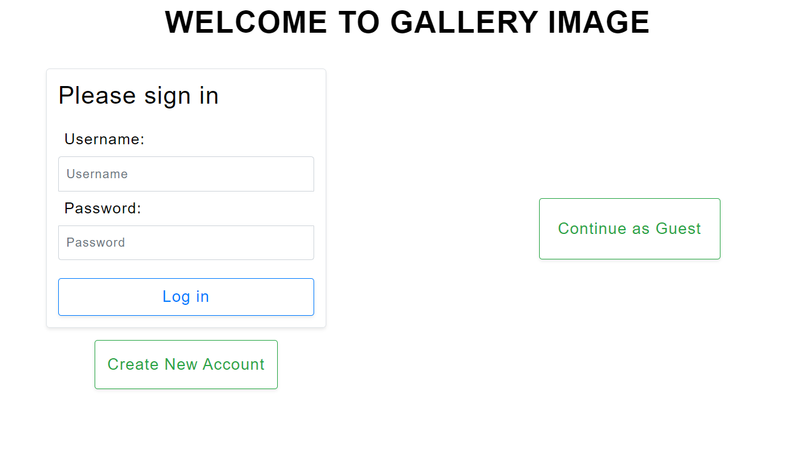
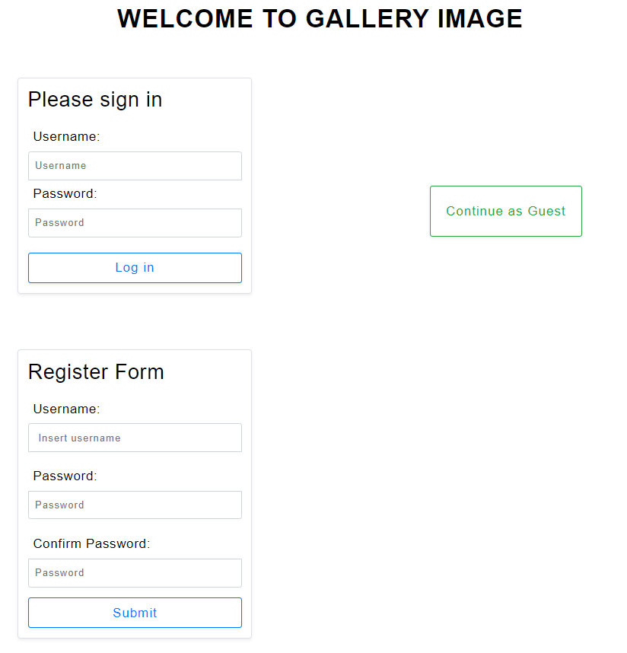
Index.html

Slide 6
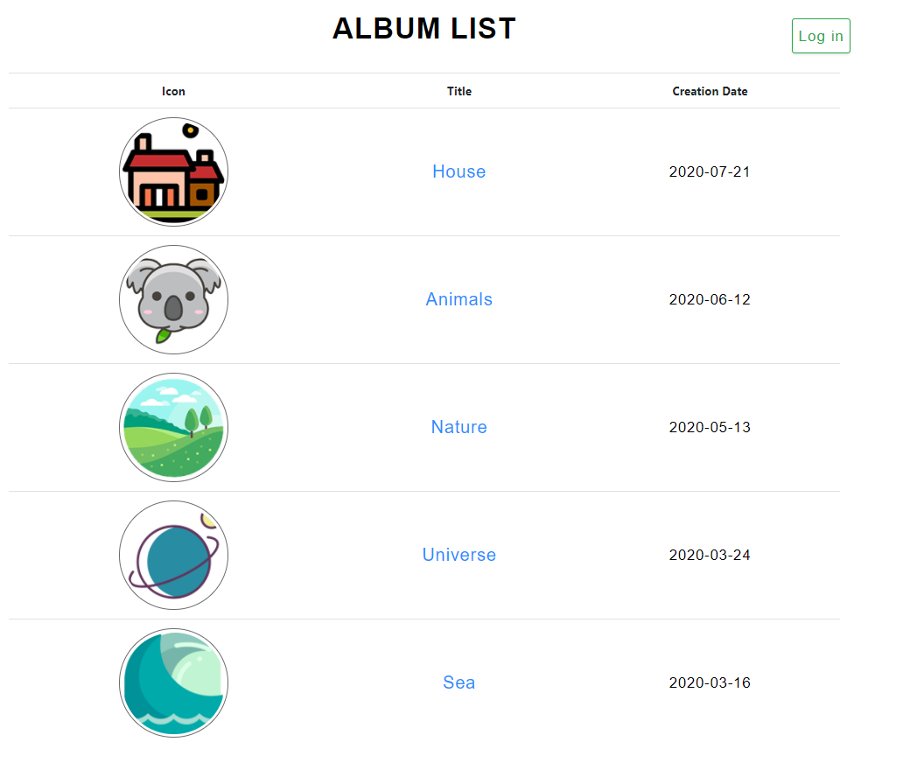
AlbumList.html
User Guest

Slide 7
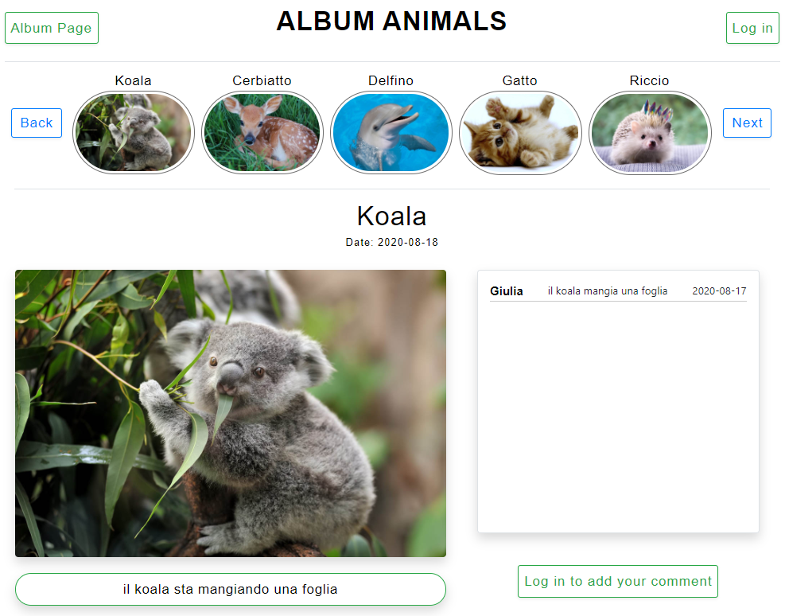
ImageList.html User Guest

Slide 8
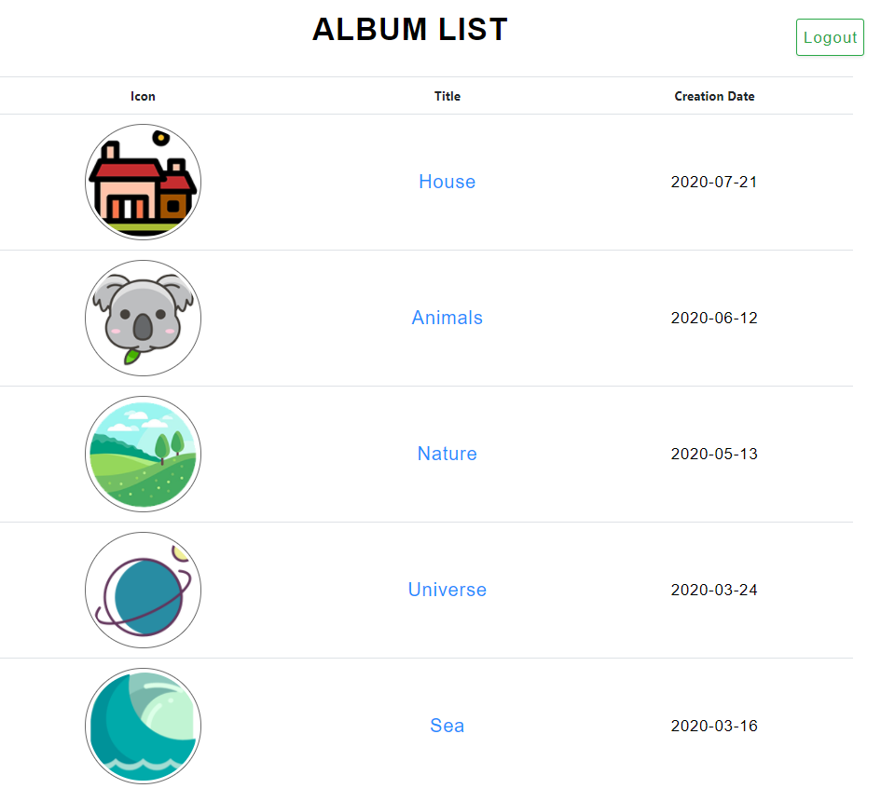
AlbumList.html User Logged

Slide 9
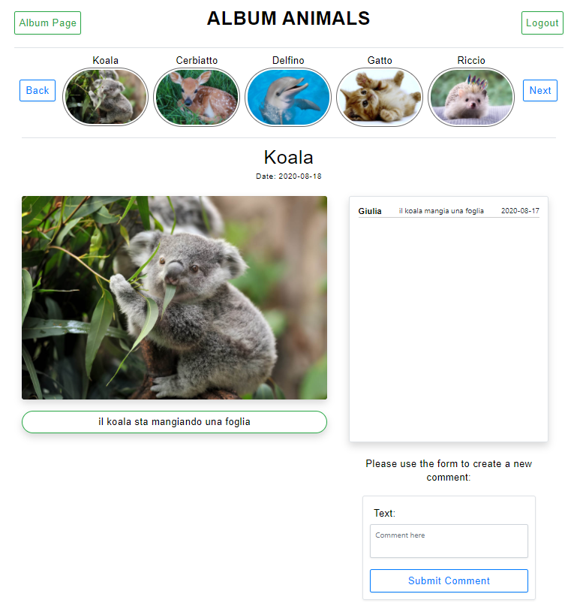
ImageList.html User Logged

Slide 10
APPLICATION DESIGN
username, password
INDEX
Login form [field: username
field: password]
user -> session
Check Login
submit
Continue as Guest
:Button
wrong user + pswd
Create New Account
:Button
submit
submit
Check Guest
ALBUM LIST PAGE
Registration form [field: username
Field: password
field: email]
Open Registration Form
submit
Registration
Wrong parameters/ status ok.

Slide 11
user.id
Next Images
GoToAlbum ListPage
GetImages OfAlbum
Previous Images
ALBUM LIST
Logout
:Button
Ctx.userLogged!=NULL
IMAGE LIST
submit
Logout
:Button
Ctx. userLogged!=NULL
AlbumPage
:Button
Next, previous
Login
:Button
Ctx.userLogged=NULL
submit
submit
Login
:Button
Ctx.userLogged=NULL
submit
:List
[databinding: image]
next
submit
previous
:List
[databinding: album]
select
image.id
:Detail
[databinding: image]
select
album.id
GetImages OfAlbum
:List
[databinding: comment]
Login to Comment
:Button
Ctx.userLogged=NULL
INDEX
GoLogin
Create comment
submit
Text, image.id, user.id
:Form
[text comment]
Ctx.userLogged!=NULL
Logout
submit

Slide 12
Server side: DAO & model objects
Model objects (Beans)
User
Album
Comment
Image
Data Access Objects (Classes)
UserDAO
checkCredentials(username, pwd)
AlbumDAO
findAllAlbums()
findAlbumById(albumId)
findAlbumTitleById(albumId)
ImageDAO
findImagesByAlbum(albumId)
findImageById(imageId)
findDefaultImage(albumId)
CommentDAO
findCommentsOfImage(imageId)
createComment(text, imageId, userId)
findUsernameOfComment(List<Comment>)
RegistrationDAO
createRegistrationOfUser(username,pwd)
controlRegistrationOfUser(userid)

Slide 13
Controllers (servlets)
CheckLogin (Guest)
CheckGuest(Guest)
CreateComment (LoggedUser)
GetImagesOfAlbum (all)
GoLogin(Guest)
GoToAlbumListPage(all)
Logout (LoggedUser)
NextImages (all)
PreviousImages (all)
OpenRegistrationForm (Guest)
Registration (Guest)
Views (Templates) & components
Index (all)
Login (form)
Create New Account (button)
Register (form)
Continue As Guest (button)
AlbumList (all)
Login/Logout(button)
Album (list)
ImageList (all)
Login/Logout(button)
AlbumPage(button)
Image (list)
Previous & next (button)
Image (Details)
Comment (List)
Comment (Form)
Login To comment (button)
Filter
LoggedUser
GuestCheck
NoChacher

Slide 14
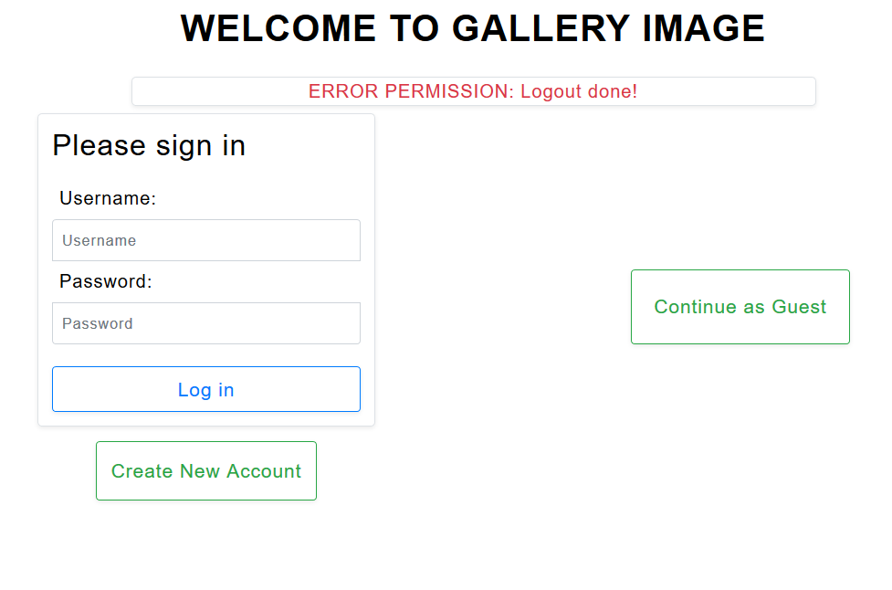
Intervenuto Filtro: CheckGuest
Gestione permessi per azioni “GUEST”

Slide 15
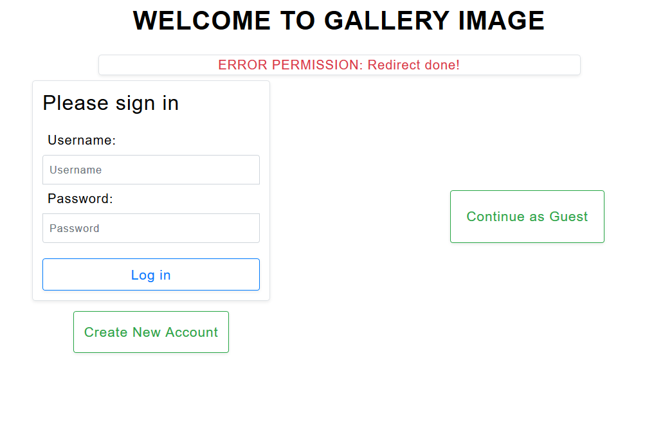
Intervenuto Filtro: LoggedUser
Gestione permessi per azioni “Logged User”

Slide 16
Event: Check Login
Post /CheckLogin
CheckLogin
UserDAO
Index.html
Session
GoToAlbumListPage
doPost()
checkCredentials(usrn, pwd)
POST:
Username -> usrn
Password -> pwd
From: index.html
User
[User == null]
Redirect “Index.html”
[User != null ] setAttribute ("user", User)
[User != null]
Redirect /GoToAlbumListPage

Slide 17
Event: Check Guest
GET /CheckGuest
CheckGuest
GoToAlbumListPage
doGet()
Redirect /GoToAlbumListPage

Slide 18
Event: Open Registration form
GET /OpenRegistrationForm ?characterDosentMatch= X &wrongPasswords= Y&checkUsername=H
OpenRegistrationForm
CTX
TemplateEngine
doGet()
ctx.setVariable("RegistrationForm", true);
Cond:[X=TRUE]
Ctx.setVariable ("CharacterDosentMatch", true);
Cond:[Y=TRUE]
Ctx.setVariable ("WrongPassword", true);
Cond:[H=TRUE]
Ctx.setVariable ("UsernameExist", true);
process("index.html", ctx, res.getWriter());

Slide 19
Event: Registration Submit
POST /Registration
Registration
RegistrationDAO
GoLogin
OpenRegistrationForm
doPost()
controlRegistrationOfUser(usrn)
Cond: TRUE || FALSE
POST:
Username -> usrn
Password -> pwd
PasswordReinserted> pwdReinserted
From: index.html
IF [Cond=True && pwd.equals(pwdReinsterd)]
createRegistrationOfUser(usrn, pwd)
Redirect /GoLogin?registrationDone=" + true
[ELSE]
[!password.equals(pwdReinserted)]
Y=True
[!registrationDAO.controlRegistrationOfUser(usrn)]
K=True
[!usernameMatch||!passwordMatch||!passwordReinsertedMatch)]
X=True
Redirect /OpenRegistrationForm?characterDosentMatch=X&wrongPassword=Y&usernameExist=K

Slide 20
Event: access to AlbumList.html
GET/GoToAlbumListPage
GoToAlbumListPage
AlbumDAO
CTX
TemplateEngine
doGet()
findAllAlbums()
albums
ctx.setVariable (“albums", albums)
ctx.setVariable (“userLogged", true/false)
process("albumList.html", ctx, res.getWriter());

Slide 21
Event: click Album
GET /GetImagesOfAlbum?albumId=X
GetImagesOfAlbum
ImageDao
CommentDAO
CTX
TemplateEngine
doGet()
findImagesOfAlbum(X)
images
ImagesToDisplay=
findImagesToDisplay(int previousImages, list<image> images)
chosenImageId = ImagesToDisplay.get(0).getId();
findCommentsOfImage(chosenImageId )
comments
selectedImage = ImagesToDisplay.get(0);
findUsernameOfComments(comments)
Update (comments)
updatePreviousAndNextValue
(0 , 0, numberOfBlocks)
albumTitle=
getAlbumTitleFromId(X)
ctx.setVariable(ImagesToDisplay, X, chosenImageId, selectedImage, comments, nextImages, previousImages, albumTitle);
process("imageList.html", ctx, res.getWriter());

Slide 22
Event: selection of Thumbnail image
GET /GetImagesOfAlbum?albumId= X &imageId= Y&nextImages=H&previousImages=K
GetImagesOfAlbum
CommentDAO
ImageDAO
CTX
TemplateEngine
doGet()
findCommentsOfImage(Y)
comments
updatePreviousAndNextValue
(H , K, numberOfBlocks)
albumTitle=getAlbumTitleFromId(X)
findImageById(Y)
selectedImage
ctx.setVariable(X, Y, selectedImage, comments, nextImages, previousImages, albumTitle);
process("imageList.html" ctx, res.getWriter());

Slide 23
Event: click next button
POST/NextImages
POST:
AlbumId → alId
nextImages → urlNextImages
previousImages → urlPreviousImages
From: imageList.html
NextImages
GetImagesOfAlbum
doPost()
La servlet aggiorna i valori di next e previous:
urlNextImages = next -1 ;
urlPreviousImages = previous + 1;
Redirect /GetImagesOfAlbum?albumId=alId &nextImages= urlNextImages &previousImages=urlPreviousImages

Slide 24

Event: click previous button
POST/PreviousImages
POST:
AlbumId → alId
nextImages → urlNextImages
previousImages → urlPreviousImages
From: imageList.html
PreviousImages
GetImagesOfAlbum
doPost()
La servlet aggiorna i valori di next e previous:
urlNextImages = next + 1 ;
urlPreviousImages = previous -1;
Redirect /GetImagesOfAlbum?albumId=alId &nextImages= urlNextImages &previousImages=urlPreviousImages

Slide 25
Event: Creation of Comment
POST /CreateComment
CreateComment
Session
CommentDAO
GetImagesOfAlbum
doPost()
getAttribute("user");
POST:
Comment → comment
ImageId → imgId
AlbumId → alId
nextImages → urlNextImages
previousImages → urlPreviousImages
user
CreateMessage(comment , imgId, user.getId())
Redirect /GetImagesOfAlbum?albumId=" + alId + "&imageId=" + imgId +
"&nextImages=" + urlNextImages + "&previousImages=" + urlPreviousImages

Slide 26
Event: Logout
GET /Logout
Logout
Session
Index.html
doGet()
[session != null ] invalidate()
Redirect “Index.html”

